Slide 1

Developing Device Drivers in Rust
Presenting
School of Computing, Engineering & Physical Sciences
BSc (Honours) Computing Science
Supervisor: Paul Keir
Moderator: Stephen Devine

Slide 2
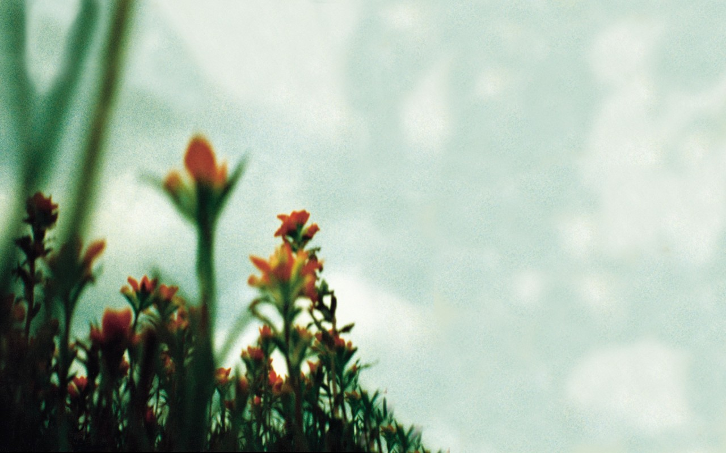
Device Drivers t h e f r a g i l e
Image: David Carson

Slide 3
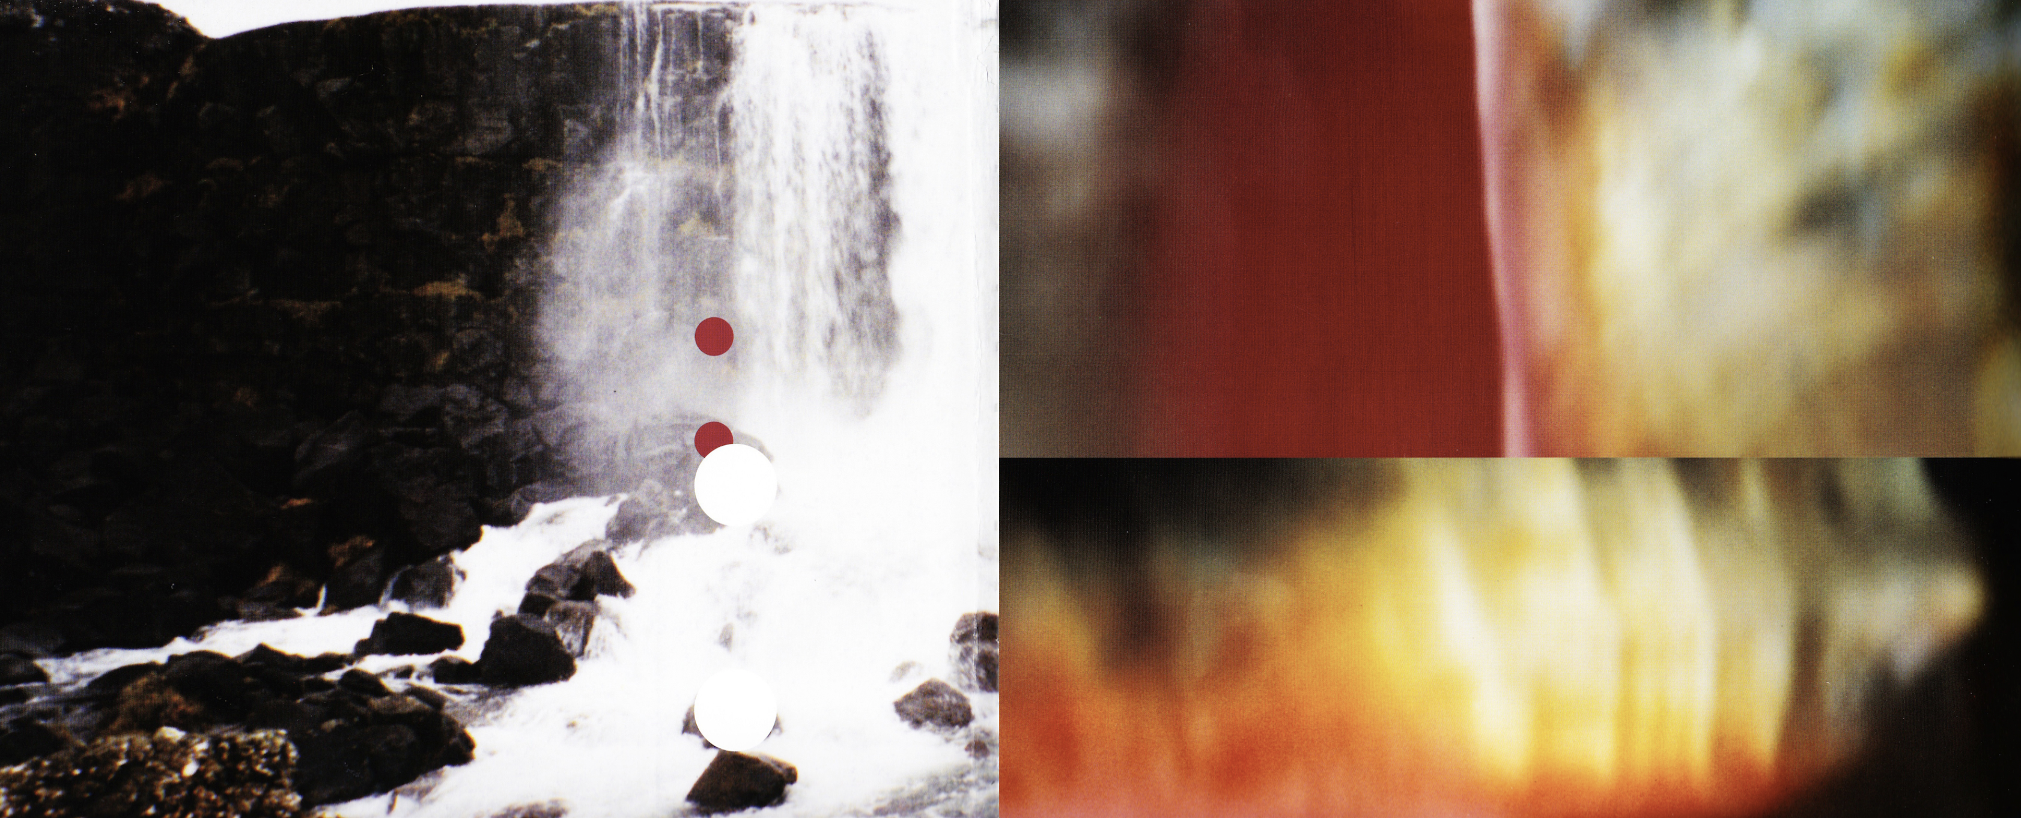
Device drivers
Problems
Control peripheral devices – interact with underlying hardware.
Provide extensions to the Operating System.
A necessity that suffers from a range of issues with dangerous consequences.
Continue to be written in C.
Originally developed 1969-1973.
Suffers from issues with memory safety.
Memory safety can lead to critical vulnerabilities and is mostly present in C, C++ and Assembly
Image: David Carson

Slide 4
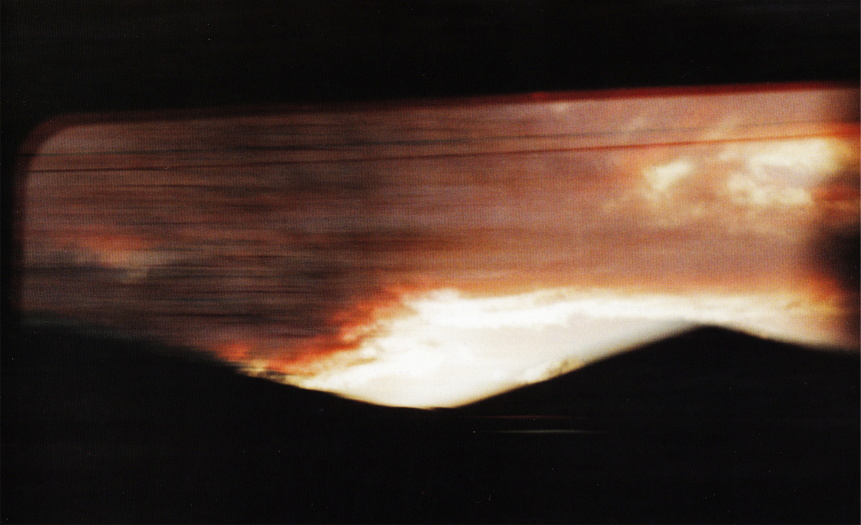
P r o j e c t a I m
Overcome previously described
issues by developing a Linux
device driver in r u s t
Image: David Carson

Slide 5
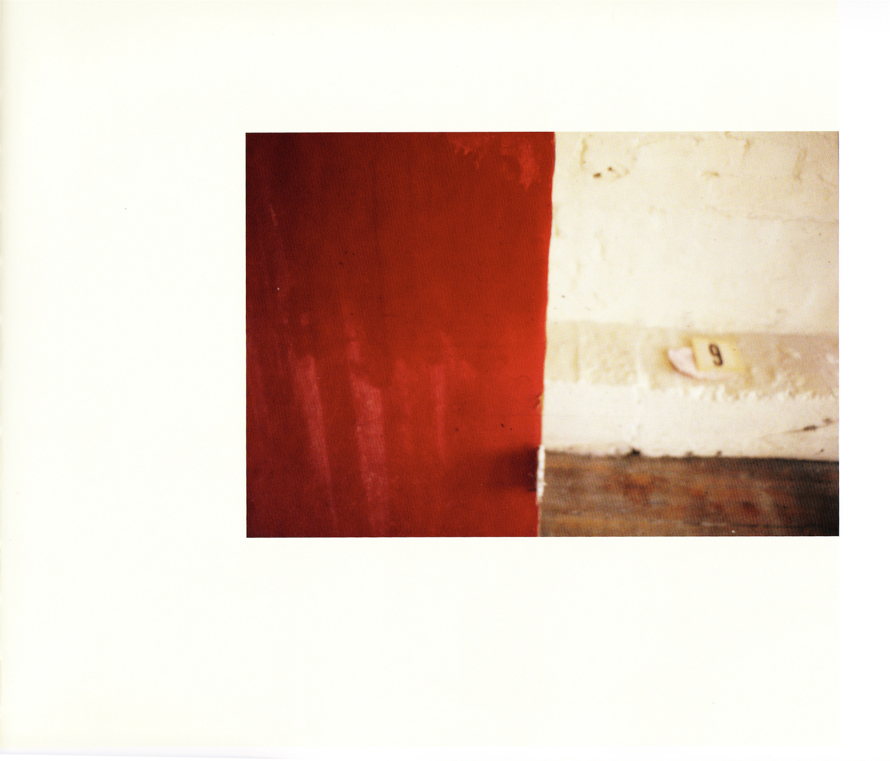
R u s t
rust for Linux
2019, Miguel Ojeda
introduce a new system programming language into Linux kernel
memory safe language
strong compiler
borrow system
variable lifetimes
Stroustrups criticism
“every safe language, including rust, has loopholes allowing unsafe code”

Slide 6
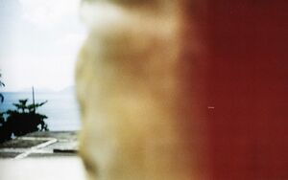
Image: David Carson

Slide 7
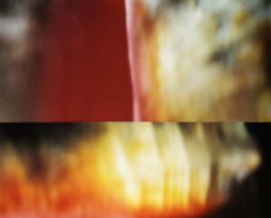
Image: David Carson

Slide 8
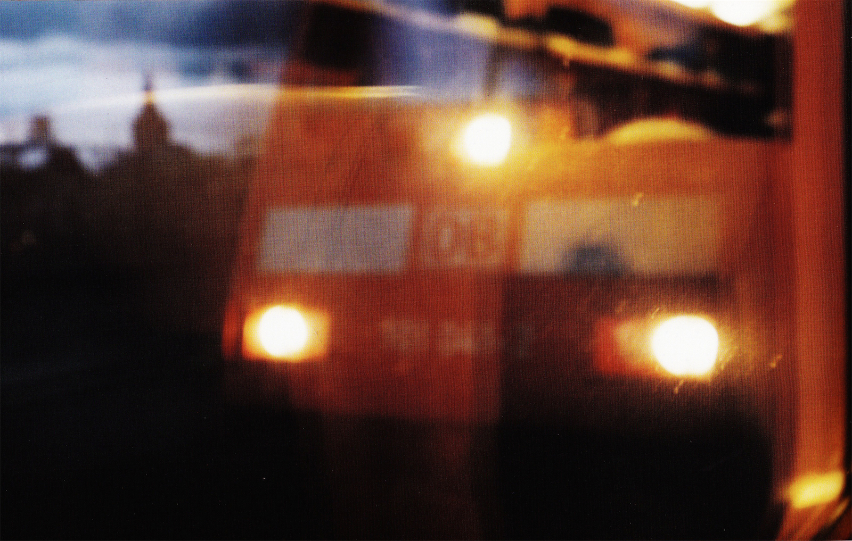
Image: David Carson

Slide 9
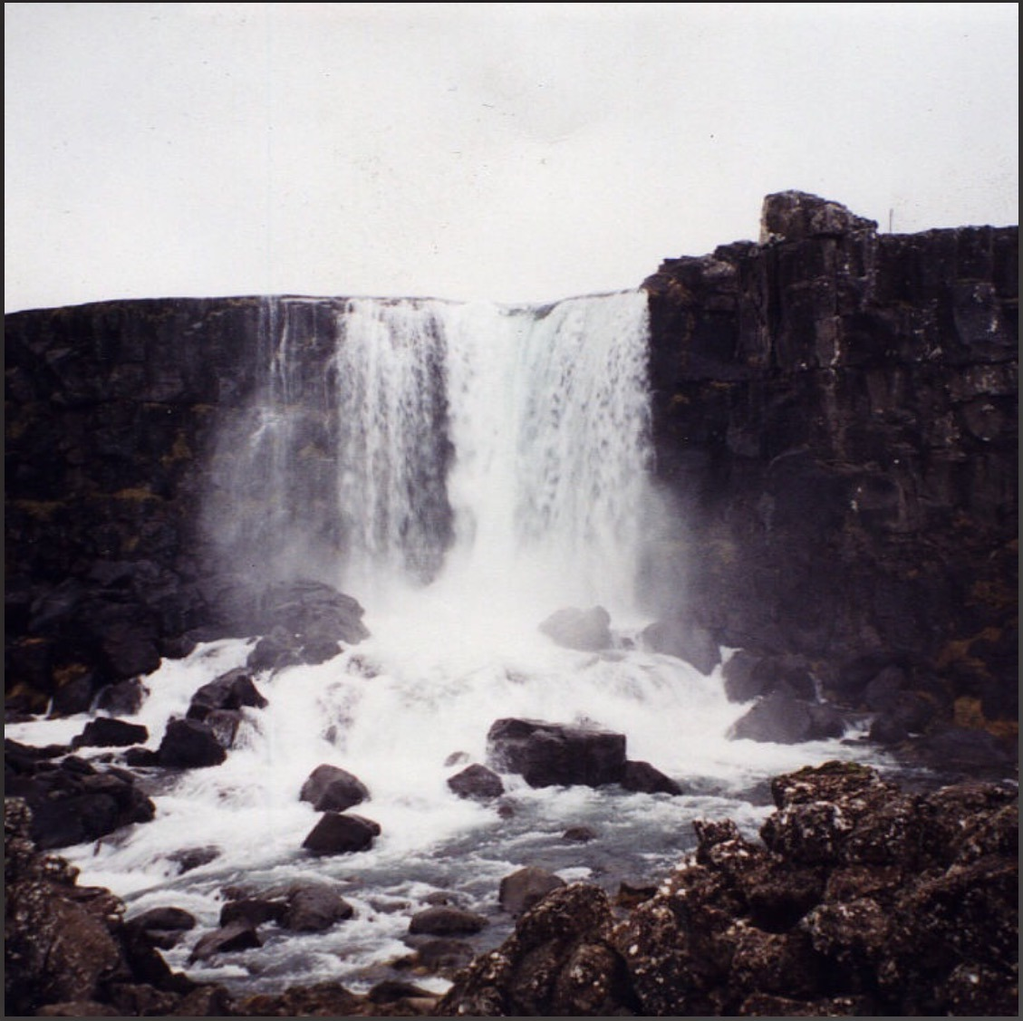
Image: David Carson

Slide 10
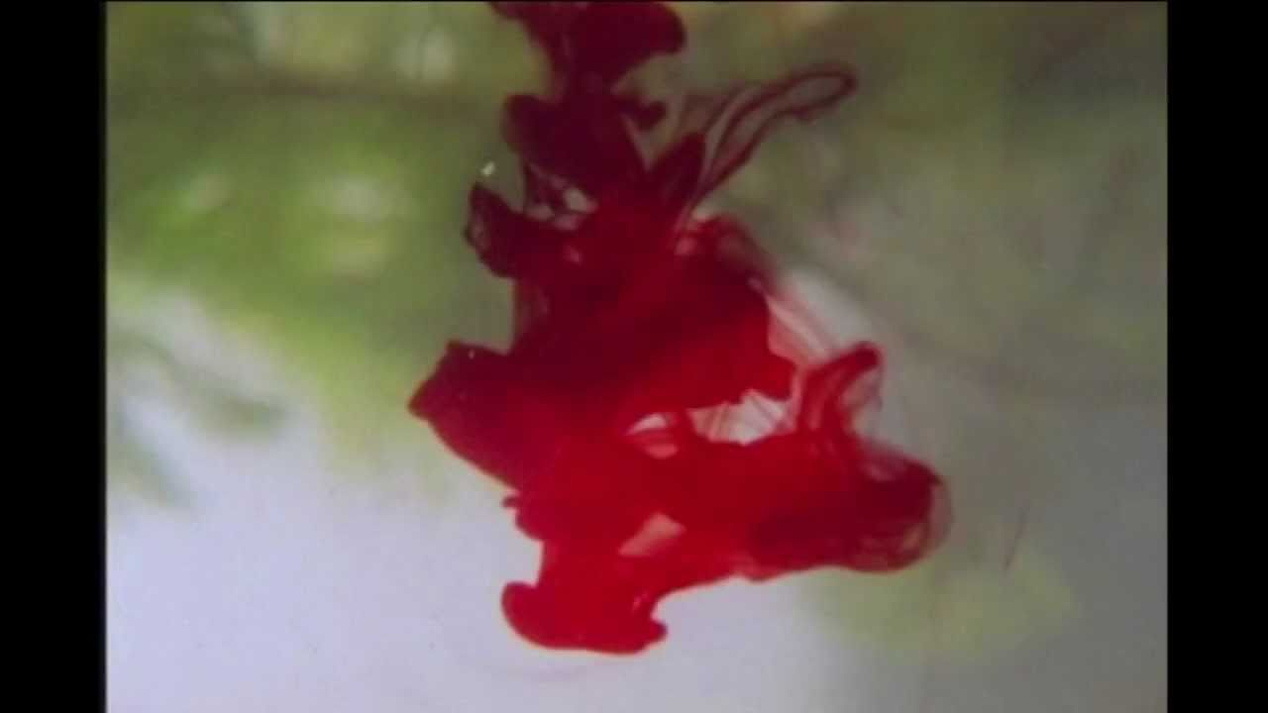
Image: David Carson

Slide 11
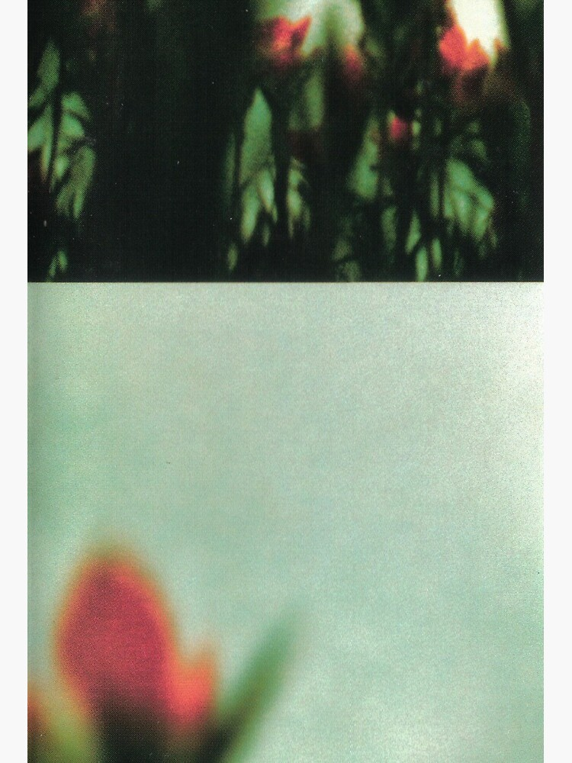
underneath it all
these slides inspired by ‘The Fragile’ by Nine Inch Nails
images credited to David Carson/Nine Inch Nails
Kyle Christie University of the West of Scotland [2023]
Image: David Carson

